Slide 1
CSCE 5350 – Fundamentals of Databases Project Presentation
Group 1
Abdul Kareem Arbaz
Gowtham Sai Lendhra Narayanam
Sai Rahul Reddy Bapuram
Syed Akhter Bahadur

Slide 2
Project Title : Backend Operations Service System(BOSS)
BOSS is defined as Backend Operations Service System. We have developed an inventory management system.
This inventory management system can be used in multiple real life application scenarios such as : Libraries, Warehouse, Convenience stores and Super Markets.
It provides comprehensive features such as :Add/Delete/Update Items, Purchase Items, Feedback on Items, Product Delivery, Product Shipment Estimate Time, and Goods Received.

Slide 3
Features in BOSS:
Add/Update/ Delete Items: Adding new items in the inventory, adjusting the existing stock in the inventory and deleting them.
Purchase Items: Customer can purchase items from the store.
Feedback on Items: Customer can provide feedback on the items brought from the store.
Product Delivery: Product can be delivered from the store to the place where the customer requires it to get delivered.
Product Shipment Estimate Time: BOSS provides an estimate time for the shipment to reach the customer.
Goods received: Markdown the inventory received from the vendor.

Slide 4



Technologies used in our project
Front-End :
HTML: Hypertext Markup Language. In our Project, HTML is used to define the structure and content of web pages, including headers, paragraphs, lists, and other elements.
CSS: Cascading Style Sheets. In our project, CSS was used to define fonts, colors, layouts, and other visual aspects of HTML elements.
React: It is a high-level, dynamic, and interpreted programming language. It is most widely used programming language for client-side scripting in web development, and it is also increasingly used on the server-side with Node.js.

Slide 5
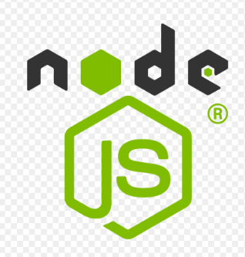

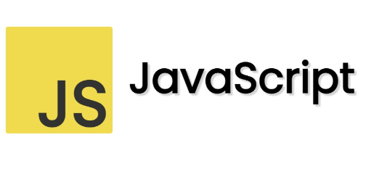
Technologies used in our project
Back-End :
Node.js:It is designed for building scalable network applications using an event-driven, non-blocking I/O model, making it efficient and well-suited for data-intensive real-time applications.
Express.js: Express.js is a minimalist web application framework for Node.js that simplifies the process of building web applications and APIs by handling HTTP requests, routing, and middleware.
JavaScript: JavaScript is a versatile programming language primarily used for web development, enabling interactive and dynamic content on websites. It offers capabilities for both client-side and server-side scripting.

Slide 6

Databases:
It is designed for building scalable network applications using an event-driven, non-blocking I/O model, making it efficient and well-suited for data-intensive real-time applications.

Slide 7
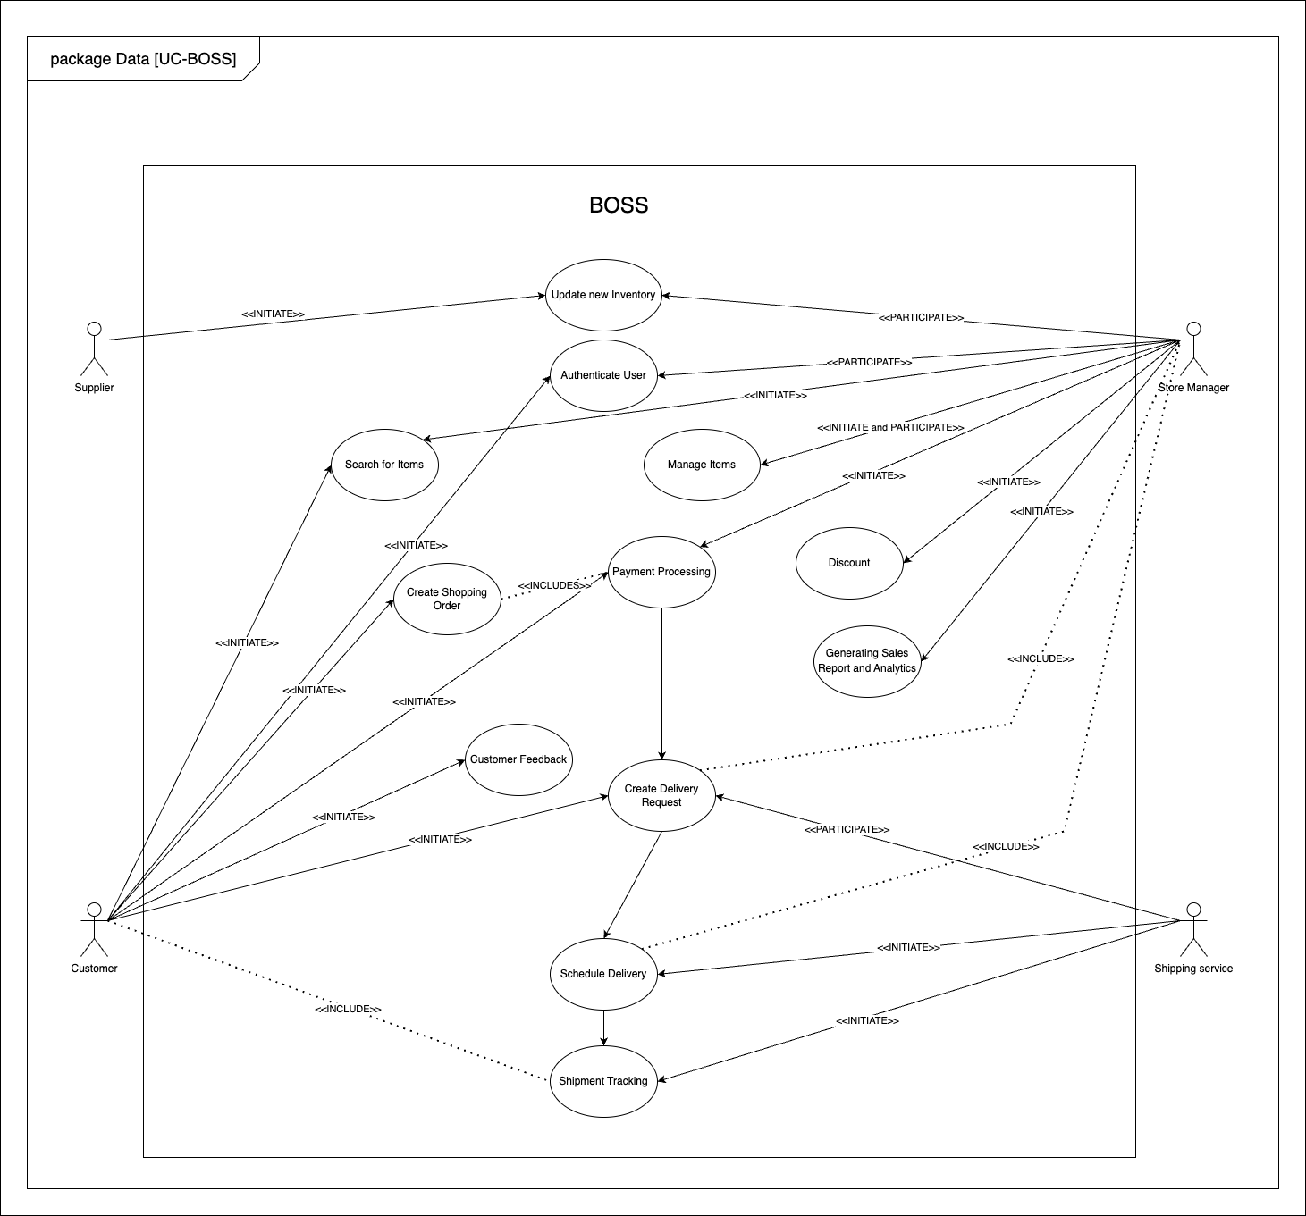
Use Case Diagram:

Slide 8
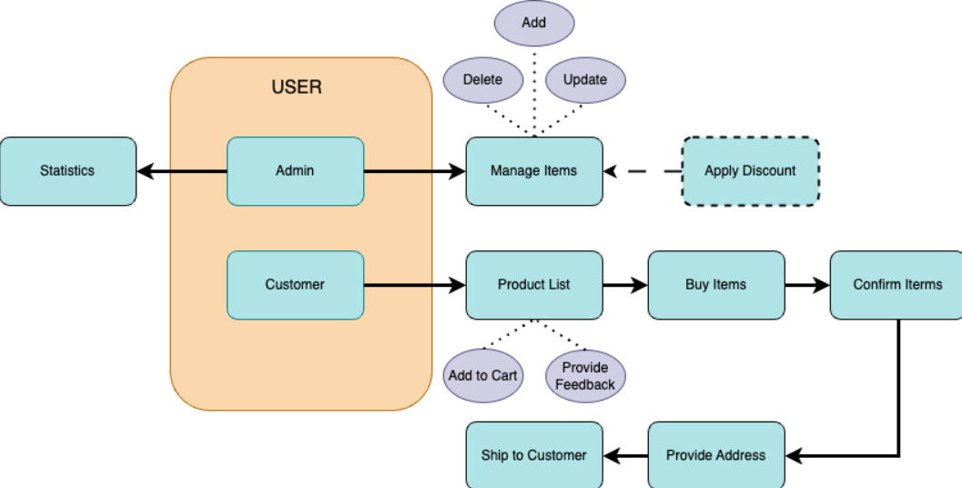
Architecture of BOSS

Slide 9
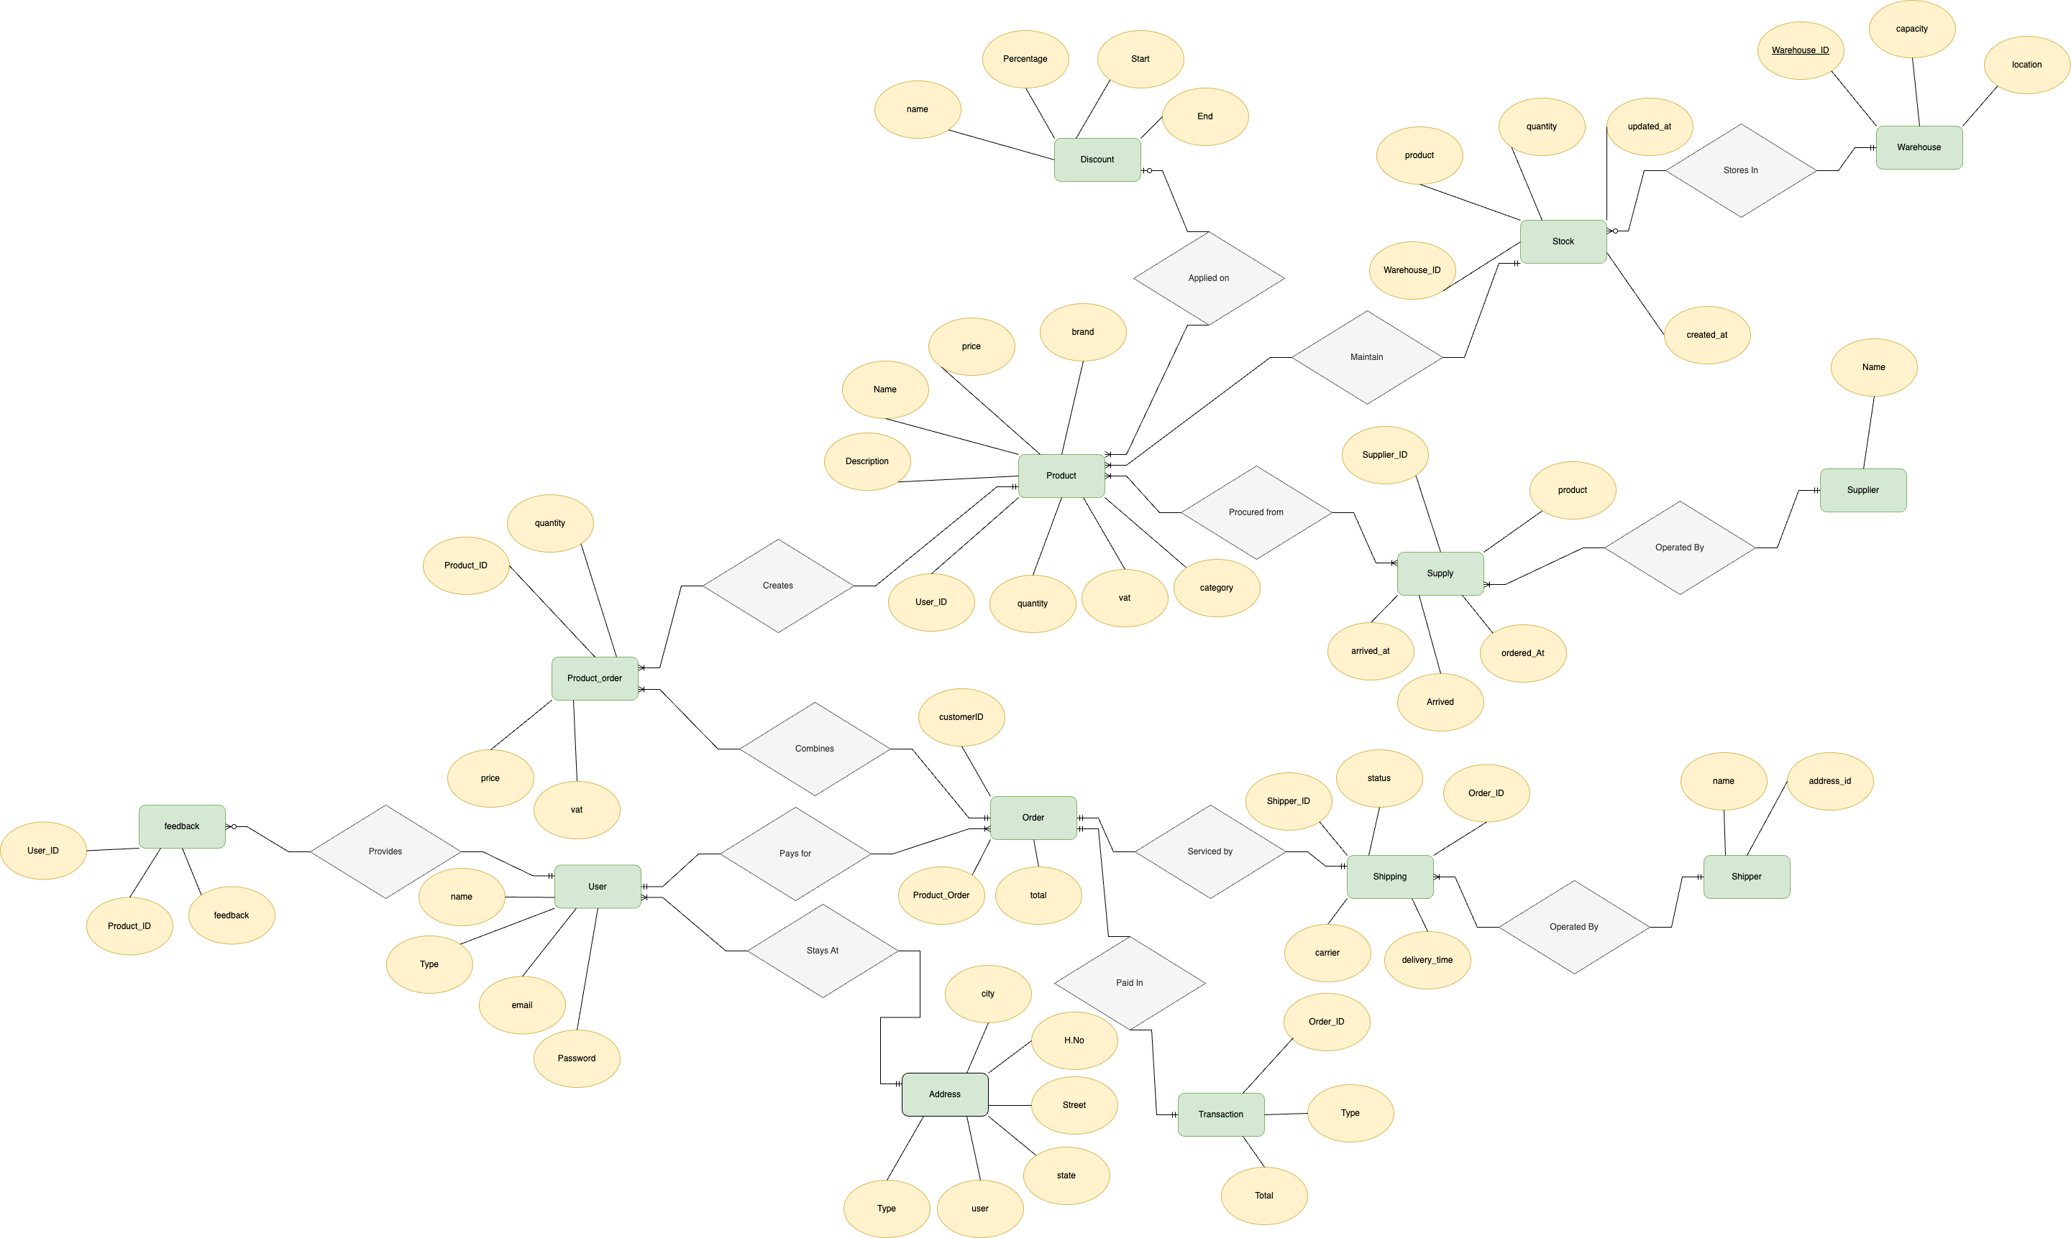
ER Diagram of BOSS

Slide 10
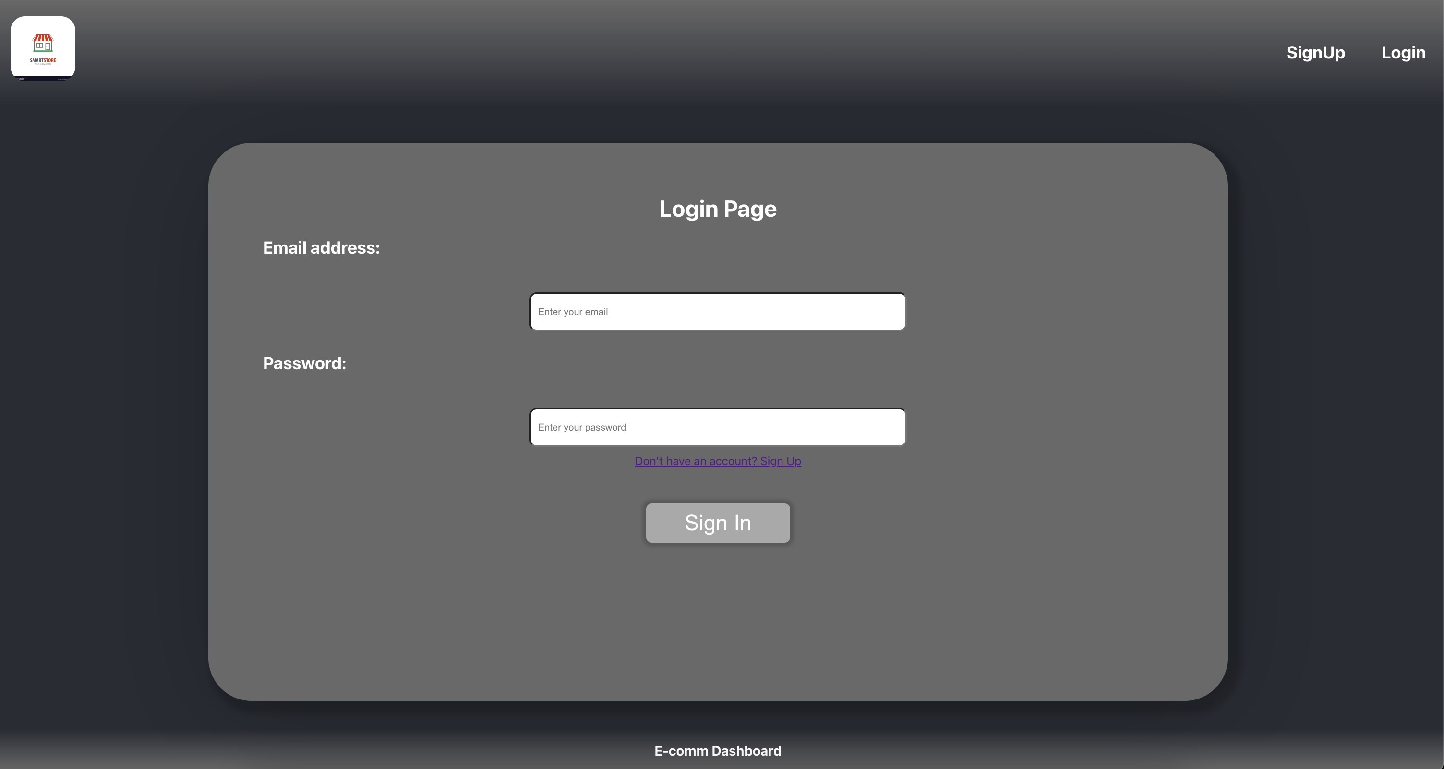
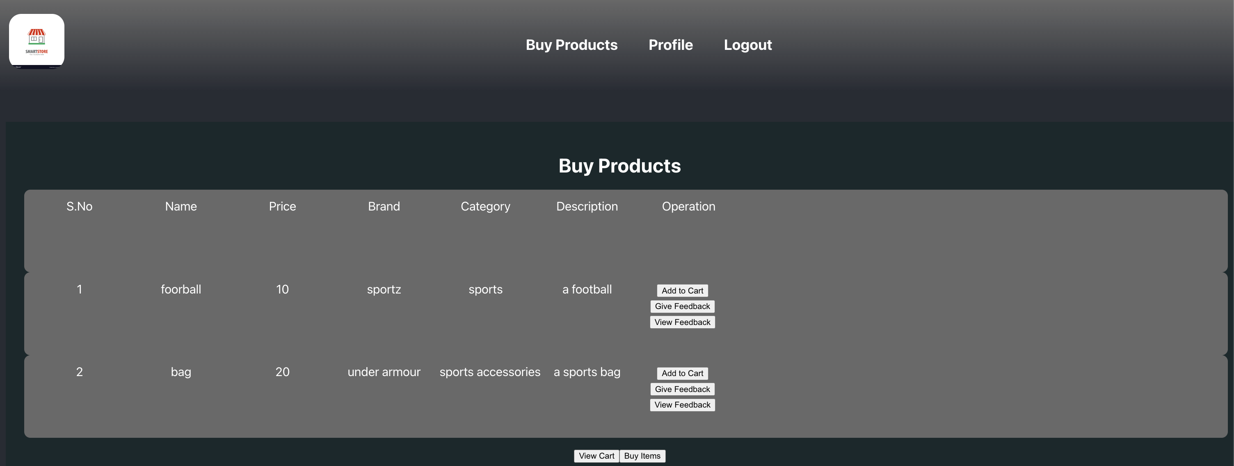
Demo:

Slide 11
